Slide 1

18ECC303J – Computer Communication Networks
Course Credit : 4
Theory : 9 Hours
Reference Text Books
1.Behrouz A. Forouzan, “Data communication & Networking”, Mc-Graw Hill, 5th Edition Reprint, 2014.
2. Andrew S. Tanenbaum, “Computer Networks”, Pearson Education India, 5th Edition, 2013.
3. William Stallings, “Data & Computer Communication”, Pearson Education India, 10th Edition, 2014.

Slide 2
Unit 3 – Network Layer
Session 6
Network Layer Protocol-IPV4
Session 7
Internet Protocol(IP)-IPV6
Session 8
Routing Protocols- Distance Vector& Link State
Routing Issues-Delivery, Forwarding and Routing
Week 8

Slide 3
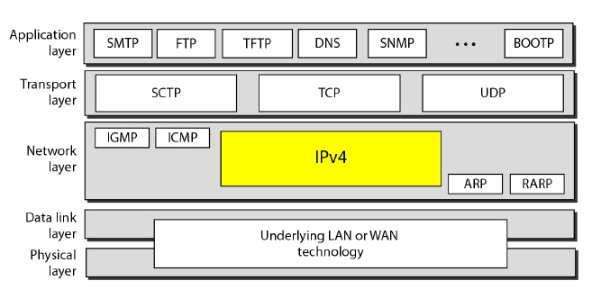
(Week 8) Session -6 Network Layer Protocol- IPv4
The Internet Protocol version 4 (IPv4) is the delivery mechanism used by the TCP/IP protocols.
IPv4 is an unreliable and connectionless datagram protocol.
IPv4 provides no error control or flow control (except for error detection on the header).
IPv4 assumes the unreliability of the underlying layers and does its best to get a transmission through to its destination, but with no guarantees. (Best Effort Service Model)
If reliability is important, IPv4 must be paired with a reliable protocol such as TCP.
IPv4 is also a connectionless protocol for a packet-switching network that uses the datagram approach.
IPv4 relies on a higher-level protocol to take care of all these problems.

Slide 4
IP Services
Delivery service of IP is minimal
IP provides un unreliable connectionless best effort service.
Unreliable: IP doesn’t make an attempt to recover lost packets
Packet can be lost, duplicated, delayed, out-of-order
No notification of such problems
Best-effort: Does not make guarantees on the service
Makes earnest attempt to deliver (IPv4 provides no error control or flow control, No throughput output, No delay guarantee)
Connectionless
Each Packets treated independently

Slide 5
Purpose of the IP
IP: protocol that defines delivery service
Specifies basic unit of transfer
Exact format of data
Performs the routing function
Chooses the paths for packets
Includes rules for unreliable packet delivery
How hosts and routers process packets
How and when error messages are generated
When packets can be discarded

Slide 6

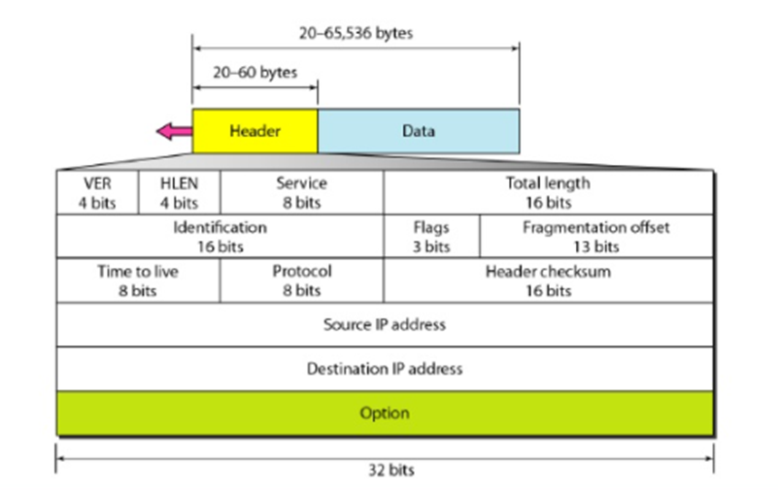

Datagram:
Packets in the IPv4 layer are called datagrams
The datagram begins with a header followed by a data (or payload)
The header is 20 to 60 bytes in length and contains information essential to routing and delivery.
It is an 4 byte section (i.e. 32 bits)
The payload size of a datagram is determined by the application that sends data.
Allowing the size of datagrams to vary makes IP adaptable to a variety of applications.

Slide 7
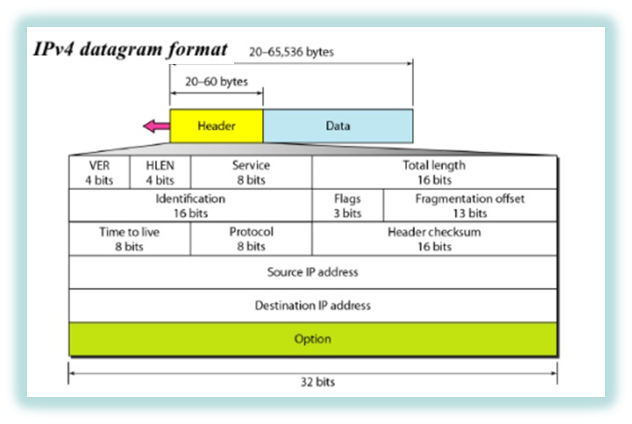
Datagram Format
Version (VER)
This 4-bit field defines the version of the IPv4 protocol.
Currently the version is 4. (0100)
For IPV6 – version is 6 – represented as 0110
This field tells the IP software running in the processing
machine the datagram format is 4
If the version of IP changes, then the datagram is discarded .
Header length (HLEN)
This 4-bit field defines the total length of the datagram header in 4-byte words.
The length of header is variable length from 20 to 60 bytes
If there are no option, the value of field is 5 ( 5 x 4 = 20 bytes)
If the value of field is 15 (15 x 4 = 60 bytes)
The value of the field varies from 5 to 15
Notes:
Datagram format
a succession of 32-bit words
Packet formats at the internetworking layer and above are almost invariably designed to align on 32-bit boundaries
To simplify the task of processing them in software

Slide 8
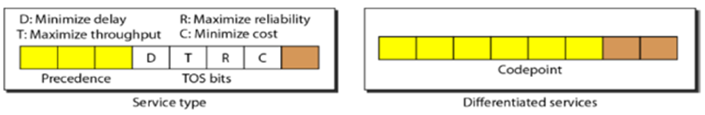
Datagram Format
Services
IETF (Internet Engineering Task Force) has changed the interpretation and name of this 8-bit field.
This field previously called service type,
is now called differentiated services.
In service type the
first 3 bits are called precedence bits.
defines priority of the datagram – during congestion
starts from 000 to 111
• If a router is congested
needs to discard some datagram’s
lowest precedence are discarded first
The next 4 bits
The next 4 bits is type of service (TOS) bits with only one bit set. The last bit is not used.
TOS bits Description
0000 - Normal service
1000 - Minimize Delay (D)
0100 - Maximize Throughput (T)
0010 - Maximize Reliability (R)
0001 - Minimize Cost (C)

Slide 9

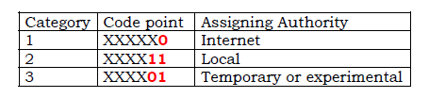
Datagram Format
Differentiated service
In differentiated services
6 bits define code point , last 2 bits unused.
In code point
If rightmost 3 bits are 0s, the 3 leftmost bits are same as precedence.
If 3 rightmost bits are not all 0s, the 6 bits define 64 services based on the priority assignment by the Internet or local authorities.
First category (Numbers 0,2,4, ….62) - is assigned by Internet authority
Second category (Numbers 3, 7,11, 15 …..63) – by Local authority
Third category (1, 5, 9, ….61) - is temporary and used for experimental purpose

Slide 10
Datagram Format
Total length
The 16-bit field defines the total length (header plus data).
The total length of the IPv4 datagram is restricted to 65,535 bytes (2^16 - 1).
If the length is large for certain lower layer protocols, then fragmentation is done.
Some lower layer protocols impose minimum payload length, in such case padding is done.
Time to live
Defines lifetime of the datagram.
This field is used to control the maximum number of hops (routers) visited by the datagram.
When the source host sends a datagram, it stores a number.
Each router that processes the datagram decrements this number by 1.
If the value becomes zero, the datagram is discarded.
Default is 64
Problems
Setting it too high the packet will loop a lot
Setting it too low the packet will not reach the destination

Slide 11
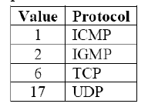
Datagram Format
Protocol
This 8-bit field defines the higher-level protocol that uses the services of the IPv4 layer.
An IPv4 datagram can encapsulate data from several higher-level protocols such as TCP, UDP, ICMP, and IGMP.
The values are
Checksum (16 bits)
Contains the checksum sequence.
16 bit 1’S COMPLEMENT addition
Source address
This 32-bit field defines the IPv4 address of the source.
Destination address
This 32-bit field defines the IPv4 address of the destination
Every packet contains a full destination address
Forwarding/routing decisions are made at each router
Notes:
Protocol: one-byte demultiplexing key
identifies the higher-level protocol to which this IP packet should be passed
values defined for TCP (6), UDP (17)
Checksum:
calculated by considering the entire IP header as a sequence of 16-bit words
adding them up using ones complement arithmetic, and taking the ones complement of the result
Checksum
The error detection method used by TCP/IP protocols is called checksum
It protects against the corruption that may occur during the transmission of a packet
It is redundant information added to the packet
The checksum is calculated at the sender
The value obtained is sent with the packet
The receiver repeats the same calculation on the whole packet including the checksum
If the result is satisfactory the packet is accepted
Otherwise it is rejected.
First, the value of the checksum field is set to 0.
Then the entire header is divided into 16-bit sections and added together.
The result (sum) is complemented and inserted into the checksum field.
The checksum in the IPv4 packet covers only the header, not the data.

Slide 12
Datagram Format
Identification, Flags, Fragmentation offset
These fields are used in fragmentation
Identification
The 16-bit field identifies a datagram.
This identification and source IPv4 address uniquely define a datagram as it leaves the source host.
To guarantee uniqueness, the IPv4 protocol uses a counter to label the datagrams.
When a datagram is fragmented, the value in the identification field is copied to all fragments.
All fragments have the same identification number, which is also the same as the original datagram.
The identification number helps the destination in reassembling the datagram.

Slide 13

Datagram Format
Identification, Flags, Fragmentation offset
These fields are used in fragmentation
Flags
It is a 3-bit field.
The first bit is reserved.
The second bit is called the do not fragment bit.
If set , the datagram would not be fragmented.
In such case, if it cannot pass through any available physical network, then it is discarded.
The third bit is called the more fragment bit.
If its value is 1, it means the datagram is not the last fragment, there are more fragments after this one.
If its value is 0, it means this is the last or only fragment.
Notes:
.

Slide 14
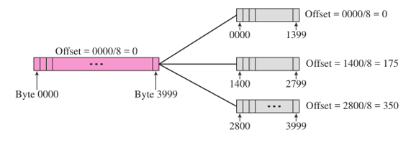
Datagram Format
Identification, Flags, Fragmentation offset
These fields are used in fragmentation
Fragmentation offset
The 13-bit field shows relative position of this fragment with respect to the whole datagram.
It is offset of the data in the original datagram measured in units of 8 bytes.
The following figure shows a datagram with a data size of 4000 bytes fragmented into 3 fragments
The original datagram are number 0 to 3999
First fragment carries bytes 0 to 1399
The offset for this datagram is 0/8 = 0
The second fragment carries bytes 1400 to 2799 the offset value for this fragment is 1400/8 = 175
The third fragment carries bytes 2800 to 3999 the offset value for this fragment is 2800/8 = 350
The Value of the offset is measured in units of 8 bytes
Because the length of the field is only 13 bits long
Cannot represent a sequence of bytes greater than 8191
Notes:
.

Slide 15
Datagram Format
Options
• The header of the IPv4 datagram is made of two parts:
A fixed part
A variable part.
Comprises the options
Maximum of 40 bytes.
It can be used for
Network testing and debugging.
• The options and their purpose are:
No Operation-- It is a 1-byte option used as filler between options.
End of Option--it is a 1-byte option used for padding at the end of the option field.
Record Route
Strict Source Route
Loose Source Route
Time stamp
Record Route
Used to record the routers that handle the datagram and can list up to nine router addresses.
Also be used for debugging and management purposes.
Strict Source Route
Used by the source to predetermine a route for the datagram.
Sender can choose a route that has minimum delay or maximum throughput.
If a datagram specifies a strict source route, all the routers defined in the option must only be visited and otherwise it would be discarded.
Loose Source Route
In loose source route each router in the list must be visited but the datagram can visit other routers as well.
Timestamp
This option is used to record the processing time by a router in milliseconds.
It helps users and managers track the behavior of routers.

Slide 16
The drawbacks of IPv4
1. Despite all short-term solutions, such as
• Sub-netting, Classless addressing and NAT
Address depletion is still a long-term problem in the Internet.
2. The Internet must accommodate real-time audio and video transmission that requires minimum delay strategies and reservation of resources are not provided in IPv4.
3. The Internet must provide encryption and authentication of data for some applications. No encryption or authentication is provided by IPv4.

Slide 17
Review Questions
Which field among flag, offset, TOS and identifier, in the IPv4 datagram is not related to fragmentation?
The TTL field has value 10. How many routers (max) can process this datagram?
In IPv4, what is the length of data field given an HLEN value of 12 and total length value is 40000?

Slide 18
Answers
TOS (TOS-type of service identifies the type of packets. It is not related to fragmentation but is used to request specific treatment such as high throughput, high reliability or low latency for the IP packet depending upon the type of service it belongs to.)
10 (TTL stands for Time to Live. This field specifies the life of the IP packet based on the number of hops it makes (Number of routers it goes through). TTL field is decremented by one each time the datagram is processed by a router. When the value is 0, the packet is automatically destroyed.)
39952 (12*4=48, 40000-48=39952)

